Slide 1
Undergraduate Education
a retrospective and the future
Presentation to the Faculty Senate
November 6, 2012
A. Scott Weber

Slide 2
Structure of our Conversation
Initiatives over the past two years
Where we are on some key metrics
Enrollment challenges on the horizon and budget implications
The future

Slide 3
Initiatives Over the Past Two Years
Finish in 4
Improving the Academic Experience
Campus Enrollment Management
Structural and Service Changes

Slide 4
Improving Time to Degree: Finish in 4
Reduce bottleneck courses
For fall 2012, 317 new sections, 12,028 new seats and 31,195 additional credits hours
Intrusive and portable advising
AdvisorTrac implementation across campus
Campus wide advising self study and external review
Strategic and timely reporting
Sophomore year experience initiative
Winter intersession

Slide 5
Improving the Academic Experience
Honors Self Study
Andy Stott, Director
Fall 2012 Entrepreneurial Academy
Yong Li, Faculty Director
Fall 2013 Sustainability Academy
Ken Shockley, Faculty Director
Fall 2013 Transcript Notation: Global Scholars Program
Center for Writing Excellence
Spring 2013 Building increased capacity in Discovery Seminars
25 seminars

Slide 6
Improving the Enrollment Landscape
Recognition on campus for the need to establish a campus wide culture of enrollment management (more on the need for this later)
Recruitment of a Vice Provost for Enrollment (underway now)
Recruitment for new Directors of Undergraduate Admissions and Financial Aid (searches to start soon)
Strategic financial aid awarding
Additional scholarship opportunities

Slide 7
Improving Structure and Service
Implementation of HUB
Enhanced delivery of service to students through Call Center reorganization
Reorganization of the Office of Financial Aid with case load approach

Slide 8
Current Metrics of Interest
Current and future tuition comparisons
Freshman admission metrics
Degree attainment metrics

Slide 9
UNDERGRADUATE TUITION & FEES
Source: AAUDE Tuition and Fees, 2012-13

Slide 10
AVERAGE FRESHMAN NET PRICE UB and NY Privates
Source: Estimates based on IPEDS Financial Aid, 2010-11

Slide 11
AVERAGE FRESHMAN NET PRICE at SUNY Institutions Net Price: Tuition and Fees Reduced by Aid and Scholarships
Source: Estimates based on IPEDS Financial Aid, 2010-11

Slide 12
FRESHMAN ENTRY COHORT QUALITY AND ACCEPTANCE RATE
Source: Institutional Analysis; Acceptance Rate from Undergraduate Admissions
Notes:
Overall Decline in State Operating Budget
Shift from >50% state to about 1/3 state

Slide 13
Retention and Graduation Metrics
Source: Institutional Analysis
Notes:
Overall Decline in State Operating Budget
Shift from >50% state to about 1/3 state

Slide 14
Enrollment Challenges on the Horizon
and Budget Implications
Key Points
Continuing enrollment shortfall
Demographic downtown
Transfer pipeline eroding
Rise in graduation rates
QUESTIONS
Can freshman class grow in size without losing quality to preserve stable undergraduate enrollments?
Can non-resident enrollments increase?

Slide 15
UNDERGRADUATE ENROLLMENT
PLAN
Source: Official Enrollment, includes full- and part-time regular enrollment.

Slide 16
PROJECTED NYS HIGH SCHOOL GRADUATES
High school graduates projected to decline ~7% through 2020

Slide 17
PROJECTED DECLINE IN APPLICATIONS
Applications to UB projected to decline ~6% by 2020

Slide 18
SUNY COMMUNITY COLLEGE Freshman Enrollments
Source: NYSED ORIS, First-time, Full-time Enrollments
*-preliminary estimate

Slide 19
ENROLLMENT IMPACT OF DEMOGRAPHICS AND SUCCESS IN FINISH IN 4
Source: Office of Institutional Analysis projections based on demographic trends and historical transfer student enrollment draw.

Slide 20
PROJECTED CHANGES IN HS GRADUATES FROM OTHER KEY STATES

Slide 21
INTERNATIONAL ENROLLMENT (Regular Enrollment, F1 Visas Only)

Slide 22
FINANCIAL CONTEXT
State Tax Funds Plus UB Tuition Revenue
$ in millions
Source: Financial Services

Slide 23
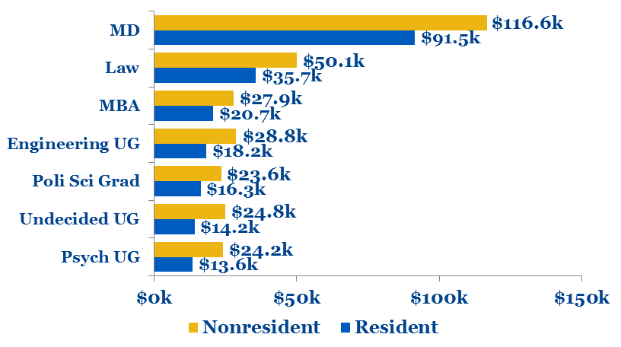
REVENUE PER STUDENT UNDER NEW SUNY BUDGET MODEL Tuition, Fees & State Support
Source: Estimates based on enrollment patterns of students in majors, Fall 2011.

Slide 24
NYSUNY 2020, SUNY RESOURCE ALLOCATION
and UB Enrollments
Window of funding opportunity afforded by Governor and
the Chancellor
means that
Achieving Enrollment Goals is Essential
Planned Tuition/Tax Revenue Growth
Funds for Faculty Hiring
Research Expansion
Economic Impact
If we are not successful, the window will close

Slide 25
The Challenges
Meeting enrollment challenges
Meeting the goals of NY SUNY 2020
Improving student quality
Improving time to degree
Seamless transfer mobility within SUNY and elsewhere
Maintaining UB’s favorable student debt load at graduation
Developing an assessment culture consistent with the needs of accreditation

Slide 26
The Future
Addressing our challenges
Meeting President Tripathi’s challenge to realize NY SUNY 2020 and make UB distinctive
So what are the big ideas for transforming the undergraduate experience?
Curriculum changes including General Education
Investment in student experience
Impact of the internet
Access
We want big ideas!

Slide 27
Questions

Slide 30
ENROLLMENT
Top-Level Issues
Enrollment management capacity
Enrollment plan development
Affordability plans
Maintaining enrollment and budget linkage
Investment in student experience
Impact of the internet – UB’s posture regarding online education

Slide 31
PLAN TO SUNY VS. 3-YEAR PLANS

Slide 32
Initiatives Over the Past Two Years
Finish in 4
Expansion of Undergraduate Academies
Transcript Notation: Global Scholars
Campus Wide Advising Self Study
Implementation of HUB
Campus Enrollment Management

Slide 33
UB ENROLLMENTS
(Plan v. Actual)

Slide 34
AVERAGE FRESHMAN NET PRICE AAU Publics
Source: Estimates based on IPEDS Financial Aid, 2010-11

